Slide 1
Medi-Cal Peer Support Specialists
General Information Jan 2024
PRESENTED BY
Gisselle Galloway
Program Supervisor

Slide 2
CalMHSA
CalMHSA is a Joint Power Authority for county behavioral health plans. CalMHSA develops and implements local, regional, and state-wide mental health services and programs on behalf of its members.

Slide 3
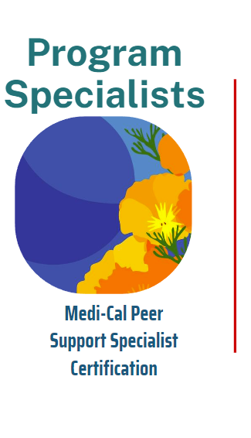
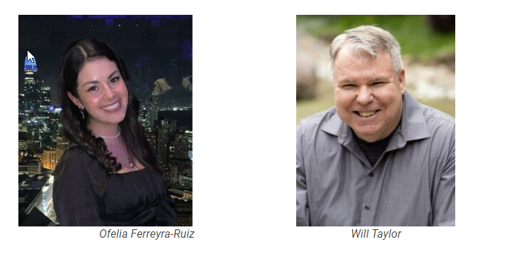
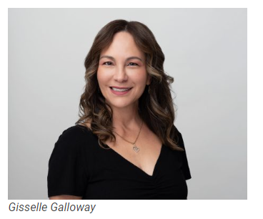
Program Supervisor

Slide 4
Other Program Staff
Tatiana, Administrative Assistance
Nivy, Epidemiologist
Mayra, Program Manager
Anna, Business Analyst
Peter, Information Technology
Lucero, Program Director

Slide 5
Background

Slide 6
Medi-Cal Peer Support Specialist Certification Implementation
SB803
DHCS
County BH
CalMHSA
Peers
Law making billing for peer services a new Medi-Cal benefit for opt-in county behavioral health plan
Oversees Medi-Cal programs and peer benefit
Sets certification standards
Sets reimbursement rates
Updates State waivers
Opt into peer benefit
Selects Certifying Entity
Contracts with DHCS
Sets up billing system for reimbursement
Employer and contract oversight
Certifying Entity
Certifies individuals
Approves training providers
Administration of “board” functions
Investigates complaints against certified peer specialists
Satisfy requirements for certification
Move across counties as a certified workforce

Slide 7
Certification and Specializations

Slide 8
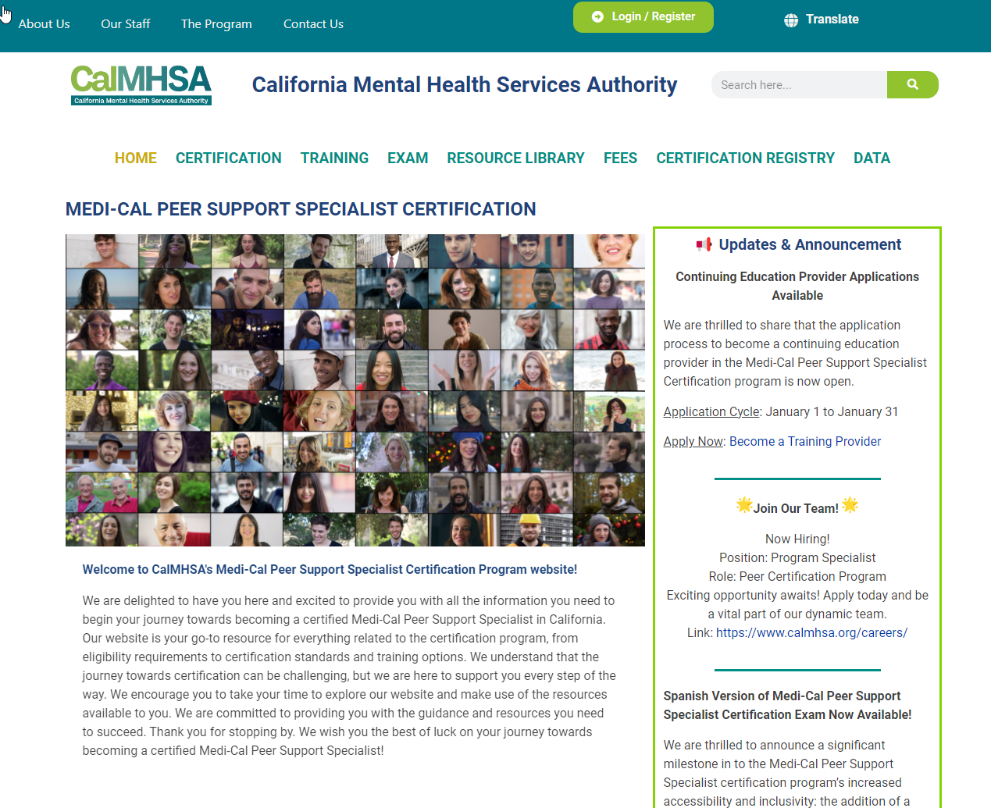
CalMHSA Certification Website
Quick overview: www.CAPeerCertification.org

Slide 9
Certification
Only one certification for Medi-Cal Peer Support Specialists is offered
Certification is for persons working with individuals in mental health and/or substance use disorders programs
Self identify as a person having personal lived experience or lived experience as a parent, caregiver, family member in mental health and/or substance use disorders

Slide 10

Medi-Cal Peer Support Specialist
Medi-Cal Peer Support Specialist Certification
Parent, Caregiver, Family Member Peer
Specialization
Working with Persons - Unhoused
Specialization
Working with Persons -Justice Involved
Specialization
Working with Persons- In Crisis
Specialization
10
1 Medi-Cal PSS Certification and 4 Specializations
Notes:
In California, there is one medi-cal peer support specialist certification and 4 different areas of specialisations-
Developing core competencies in the areas of specialization for Medi-Cal Peer Support Specialist certified in California.
Areas of specialization are:
Parent, Caregiver, Family Member Peer (completed)
Working with persons who are unhoused
Working with persons who are involved in justice system
Working with persons who are in crisis care

Slide 11
Medi-Cal Peer Support Specialists
Scope of Practice
Educational Skill Building Groups
Engagement
Therapeutic Activity
Provided in a supportive environment in which the consumer and their families learn coping mechanisms and problem-solving skills in order to help the consumer achieve desired outcomes.
Groups promote skill building for the consumer in the areas of socialization, recovery, self-sufficiency, self-advocacy, development of natural supports, and maintenance of skills learned in other support services.
Lead activities and coaching to encourage and support consumers to participate in behavioral health treatment.
Engagement may include supporting consumers in their transitions between levels of care and supporting beneficiaries in developing their own recovery goals and processes.
A structured non-clinical activity to promote recovery, wellness, self-advocacy, relationship enhancement, development of natural supports, self-awareness and values, and the maintenance of community living skills to support the consumer’s treatment to attain and maintain recovery within their communities.
Activities may include, but are not limited to, advocacy on behalf of the consumer; promotion of self-advocacy; resource navigation; and collaboration with consumers and others providing care or support to the consumer, family members, or significant support persons.

Slide 12
Role of Certifying Entity

Slide 13


Certifying Entity- Responsibilities
Standardization
Stakeholder Advisory Council
Peer Voice
Maintaining standardization of certification across counties
Certification standards set by the Department of Health Care Services
Members representing different county regions
Input to policy development
Identification and review of training provider curricula
Identification and review of curricula competencies for the 4 areas of specialization
Inclusion of program staff who identify as Peers at CalMHSA

Slide 14
Certifying Entity- Responsibilities
Issue Certifications
Exam
Training
Reviews applications to ensure individual has satisfied requirements for certification
Issues certifications to individuals
Reviews applications for certification renewal to ensure applicant meet renewal requirements
Process reasonable accommodation requests
Administration of exam via third party
Approves training providers
Core Competency for certification
Parent, Caregiver, Family Member Peer
Peer Services- Crisis Care
Peer Services- Justice Involved
Peer Services- Unhoused
Notes:
Exam-----Human Resources Research Organization (HumRRO)- non-profit agency with experience working with government agencies and exam development.

Slide 15
Certifying Entity- Responsibilities
Data Collection
Certification Registry
Administrative
Collect and maintain records of:
Candidates applying for certification
Certified professionals
Persons who receive training from CalMHSA-approved training providers
Submit yearly reports to DHCS
Up-to-Date information on status of professional certification available on the certification website
In accordance with Code of Ethics for Medi-Cal Peer Support Specialists
Investigates complaints made against a certified Medi-Cal Peer support specialist
Takes actions against and individual’s certification
Quality assurance
Outcomes evaluation

Slide 16
Certification Requirements

Slide 17
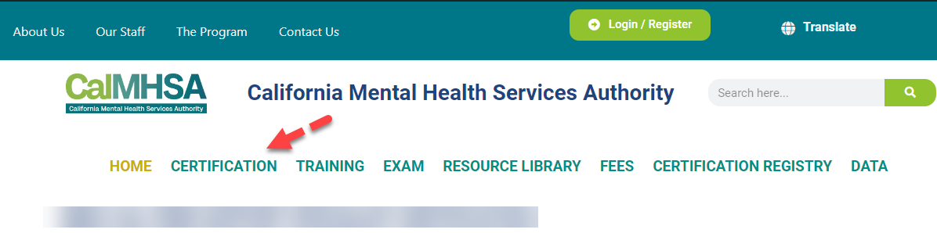
www.CaPeerCertification.org

Slide 18
Initial Certification
Certification Requirements
Submit application on the CalMHSA certification website (fees apply)
Must be at least 18 years of age or older
Possess a high school diploma, equivalent degree
Self-identify as an individual with lived experience, Peer
Be willing to share own experience as a person with lived experience to help others in their recovery
Have a strong dedication to recovery
Agree, in writing, to adhere to the Medi-Cal Code of Ethics for Peer Support Specialists in California.
Meet training requirement (80-hour Medi-Cal Peer Support Specialist training from an approved training provider)
Successfully pass the exam (fees apply)
Notes:
All candidates are required to fill out an application
Grandparenting path no longer available
Out of state reciprocity also now available

Slide 19

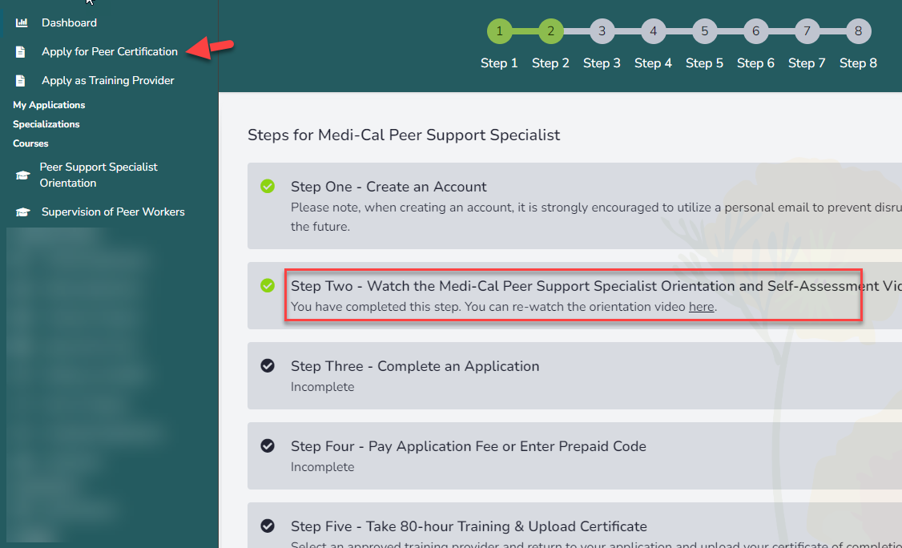
How to Apply
Register
Follow the dashboard steps ...
Create an account
Verify Email
Log into the dashboard

Slide 20
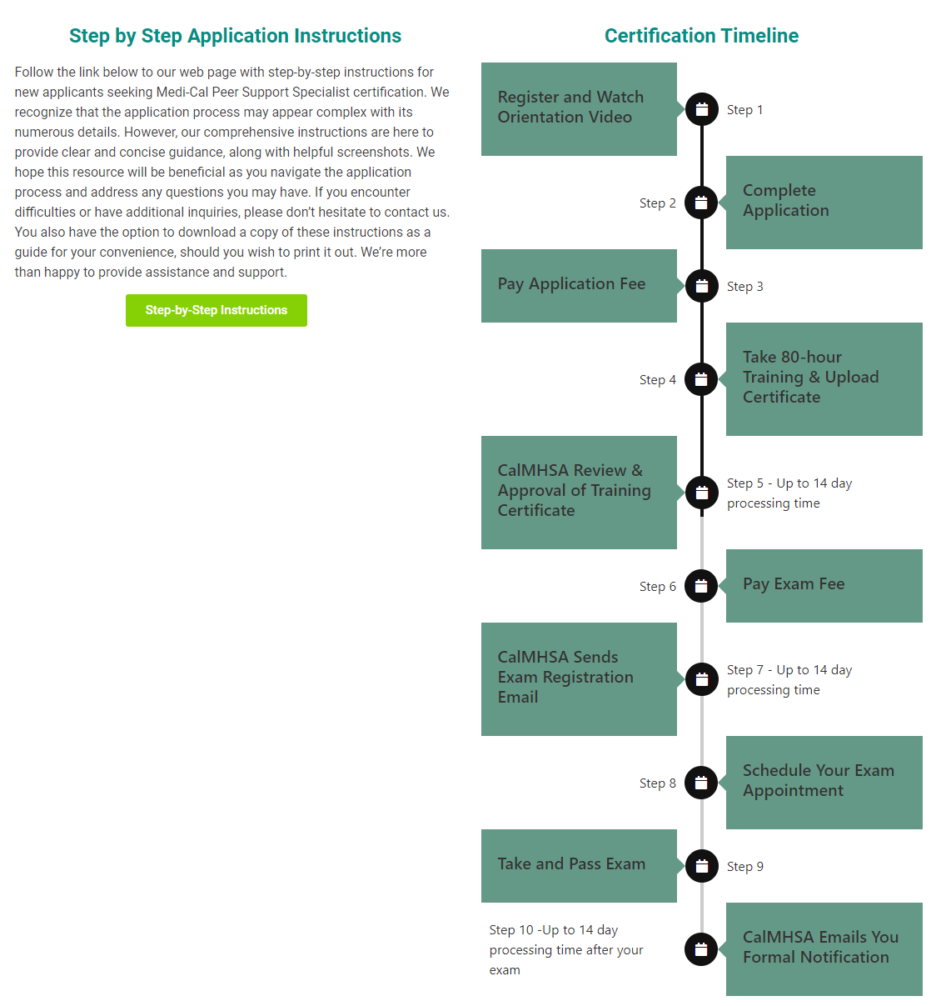
Application Process and Timeline
Note: Applications are approved for a 12-month period

Slide 21
Certification Exam

Slide 22
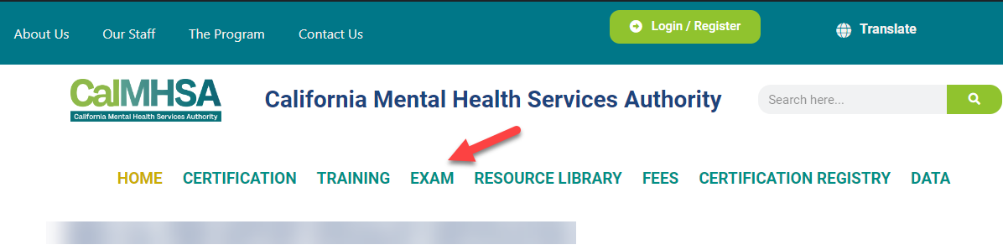
www.CaPeerCertification.org
All candidates are required to fill out an application to take the certification exam.

Slide 23
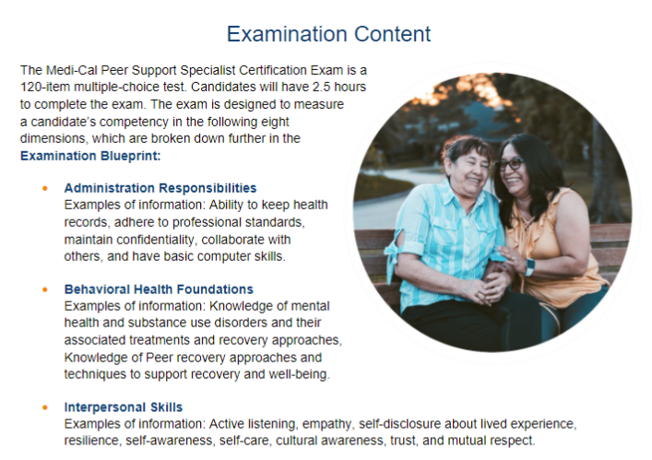
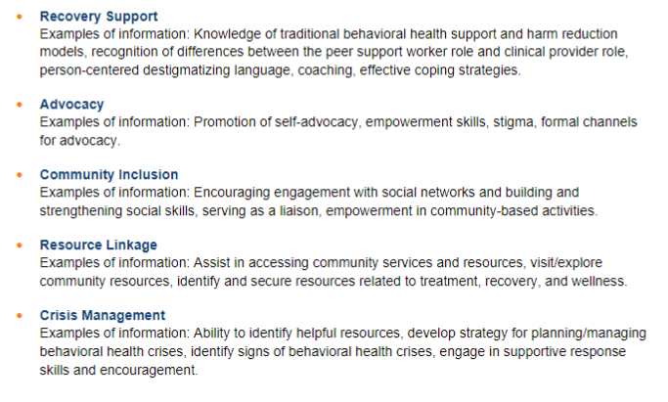
Certification Exam
120-item multiple choice exam

Slide 24
Certification Exam
Important Information
Reasonable accommodations requests are available to take the exam
  Must submit request with CalMHSA prior to scheduling exam
  CalMHSA form must be used and signed by a medical provider
  CalMHSA has a 30-day review period for requests
Exam is administered by a third party- Pearson VUE
  In-person testing centers throughout CA
  On-line with live proctoring
Rescheduling and Cancelation of scheduled exam:
  For online exams, you can cancel or reschedule your exam at any time, up to one hour BEFORE your scheduled appointment.
  For in-person testing centers, you can reschedule or cancel your exam at any time, up to 48-hours BEFORE your scheduled appointment
  Waiting until you are outside the cancellation window to cancel, you will not be able to cancel/reschedule your appointment, will forfeit the entire exam fee, and will be considered a no-show for the appointment. You will not be able to reschedule your appointment until you submit a retake request and pay associated fees to CalMHSA.

Slide 25
Certification Renewal (Biennial)

Slide 26
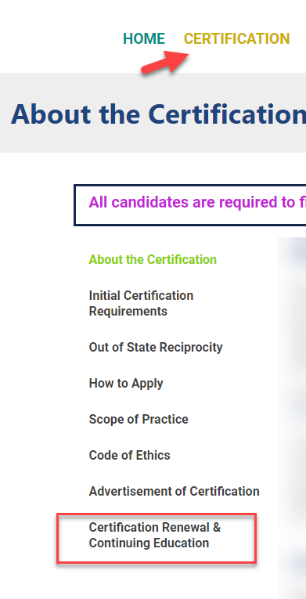

Slide 27
Certification Renewal
State Standards
CE Hours Accepted
Renewal application every 2 years (up to 90 prior to expiration)
Requires 20 hours of continuing education, Inclusive of 6 hours of Law and Ethics prior to submitting application for renewal
Certification is considered expired if not renewed by its expiration date.
  Certification expiration is within one year from its expiration date, applicant may renew certification if applicant pays renewal and late fees.
  Certification expiration is within 1-4 years from its expiration date, applicant may renew certification if applicant successfully passes the certification, pays renewal fee, late fee, and exam fee.
  Certification expiration is beyond four years from its expiration date, applicant must reapply for initial certification.
Applicants must read and re-sign agreements to adhere to the Code of Ethics for Medi-Cal Peer Support Specialists in California.
Pay associated fees
CalMHSA-approved continuing education (CE) training providers (now processing)
The following pre-approved courses taught by CalMHSA-approved training providers
  Medi-Cal Peer Support Specialist Core Competency Training
  Peer Services Specialized Training
Training that is offered by the County Behavioral Health Departments, and its contracted network providers.
Training courses completed through accredited schools, including vocational education.
Training courses by professional certification and licensing boards (i.e., CAADE, CADTP, CAMFT, BBS, APA).

Slide 28
Supervision of Peer Workers

Slide 29
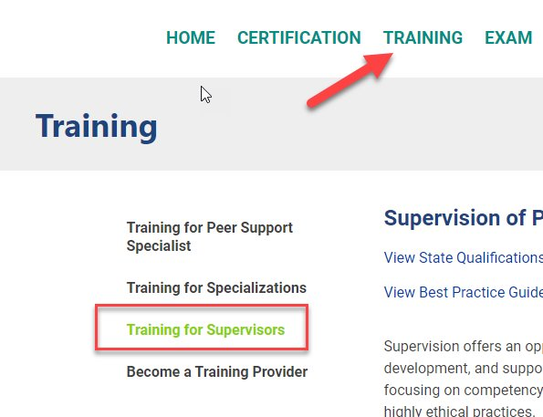
www.CaPeerCertification.org

Slide 30
Supervision of Medi-Cal Peer Support Specialists
Option 1
Option 2
Option 3
Have a Medi-Cal Peer Support Specialist Certification; and
Have two (2) years of experience working in the behavioral health system; and
Have completed an approved supervisory training.
Be a non-peer behavioral health professional, including registered or certified substance use disorder counselor; and
Have worked in the behavioral health system for a minimum of two (2) years; and
Have completed an approved supervisory training.
Have a high school diploma or general equivalency degree (GED); and
Have four (4) years of behavioral health direct service experience. May include peer services; and
Have completed an approved supervisory training.
Note. Medi-Cal Peer Support Specialist Supervisors must take a DHCS-approved Peer Support Supervisory training within 60-days of beginning to supervise a Medi-Cal Peer Support Specialist.

Slide 31
Supervision Standard
Complete the CalMHSA “Supervision of Peer Workers” training
Training course is free to everyone on the certification website)
Training shall be completed within 60-days of starting the supervision of Medi-Cal Peer Support Specialists
Training is based on SAMHSA’s best practice standards
Training is a 1-hour self-paced training

Slide 32
Data Snapshot

Slide 33
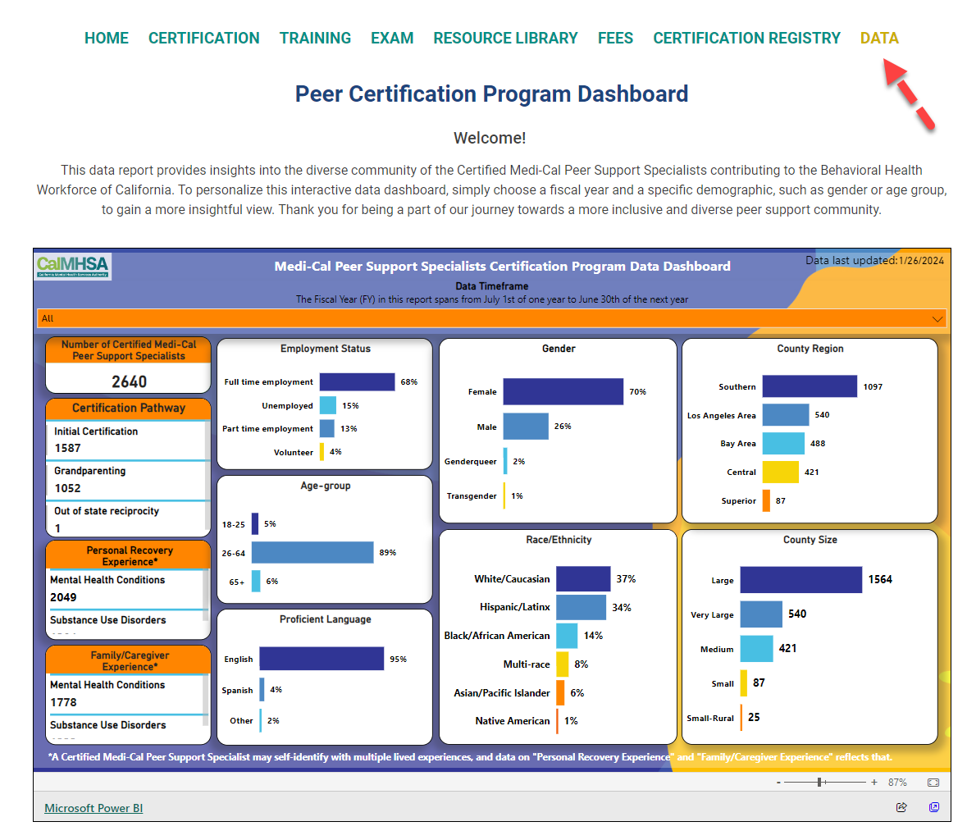

Data Dashboard
Notes:
Counties without PSS Applications: Alpine, Plumas, Napa, Sierra, Del-Norte
N=3101

Slide 34
Certification Registry

Slide 35
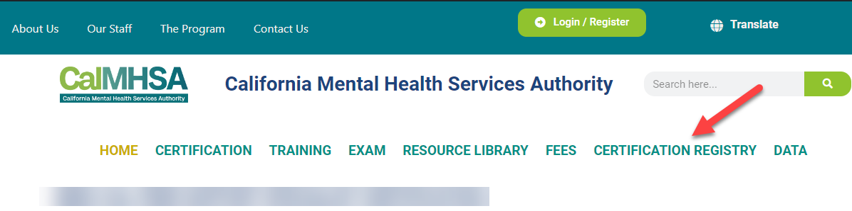
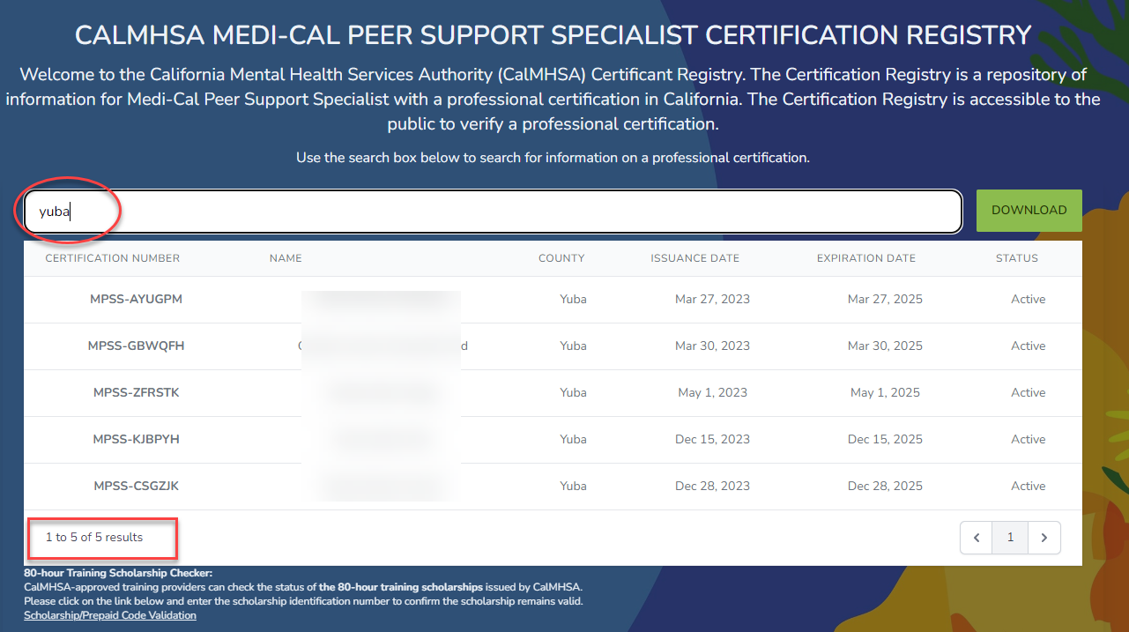

Slide 36
Resources

Slide 37
CalMHSA Certification Website
Quick overview: www.CAPeerCertification.org

Slide 38
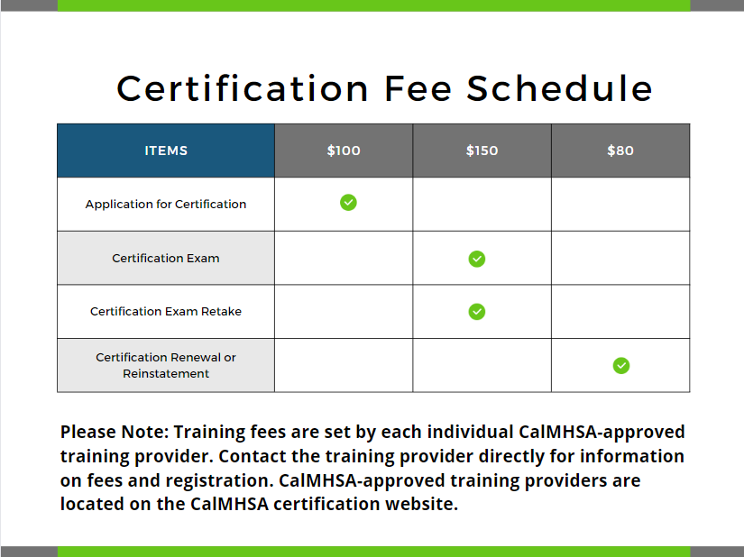
CalMHSA Fee Schedule

Slide 39
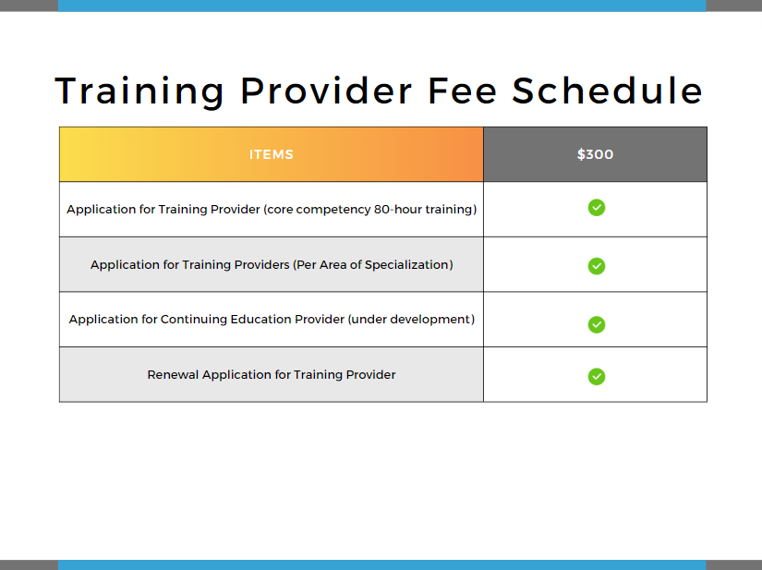
CalMHSA Fee Schedule

Slide 40
Ways to Communicate
Certification Website
Email
Phone Inbox
www.CAPeerCertification.org
PeerCertification@calmhsa.org
(279) 234-0699
Mon-Fri 8 – 5 PM, excluding holidays.

Slide 41
Links
CalMHSA Certification Website: www.CAPeerCertification.org
  General certification information: https://www.capeercertification.org/certification/
  Code of Ethics: https://www.capeercertification.org/code-of-ethics/
  Details on CalMHSA-approved training providers: https://www.capeercertification.org/training-for-medi-cal-peer-support-specialist/
  Exam preparation guide: https://www.capeercertification.org/certification-exam/
  Reasonable accommodations requests: https://www.capeercertification.org/exam-accommodations

